Slide 1
TECHNOLOGY INDUSTRY IN AFRICA
Women and men involved in the revolution of technology across Africa

Slide 2
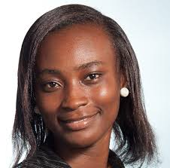
Anne Amuzu
Co founder Nandi mobile limited.
She is an oriented software entrepreneur and a software developer.

Slide 3

Lucy Quist
She is the founder and CEO of Quist Blue Diamond.
She is a co-founder of fresh bakery.
She is also a co-founder of Executive Women Network.

Slide 4

Ethel Delali Cofie
She is an IT professional, entrepreneur and consultant.
Founder of women in Tech Africa .
CEO and founder of EDEL Technology consulting.

Slide 5
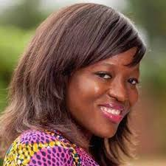
Regina Honu
She is a Ghanaian social entrepreneur and software developer.
She is the founder of Soroko solutions.
Started Tech Need Girls Ghana.

Slide 6
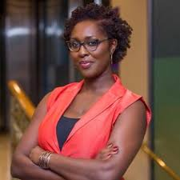
Akosua Annobil
She is a global communication consultant.
She is a founder of AB2020 and Tech in Ghana.

Slide 7
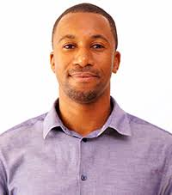
Dr. Bright Gameli
He is the head of security services in Internet Solutions Kenya.
He is a co founder of Africa Hackon

Slide 8
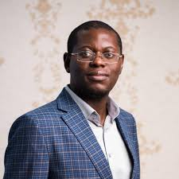
Bright Simons
He is a Ghanaian social innovator and an entrepreneur.
He is the founder and president of mpedigree.

Slide 9
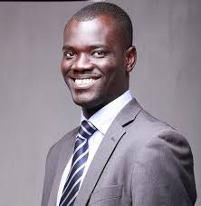
Alex Bram
He is a Ghanaian.
He is the CEO of SMSGH which is the leading business sms provider in Ghana.

Slide 10
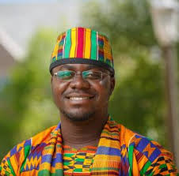
Raindolf Owusu
He is an IT entrepreneur and software engineer.
He is the CEO of oasis websoft.

Slide 11
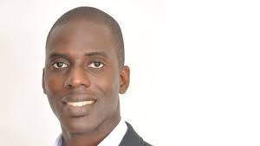
Kofi Dadzie
He is the co founder of Rancard Solutions and has been the CEO from 2006.

